Slide 1
CEGE0004: Machine Learning for Data Science Lecture 9: Unsupervised Learning Dr. Aldo Lipani

Slide 2

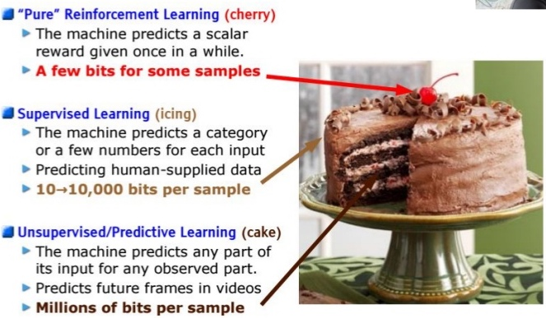
Unsupervised Learning
The vast majority of data is unlabeled:
We know X but we don't know Y
"If intelligence was a cake, unsupervised learning would be the cake, supervised learning would be the icing on the cake, and reinforcement learning would be the cherry on the cake"
Yann LeCun
In unsupervised learning, we care about finding interesting relationship in the data:
Can we visualize it?
Can we discover subgroups among the variables or among the observations?

Slide 3
Unsupervised Learning Techniques
These are often performed as part of an exploratory data analysis.
Dimensionality Reduction
Projection (PCA)
Manifold Learning (LLE)
Clustering
Divide the data into a number of groups.
Anomaly Detection
Learning what normal data looks like.
Density Estimation
Estimating the PDF of random processes that generated the dataset.

Slide 4
Evaluating Unsupervised Learning
You now know lots about supervised learning.
Unsupervised learning is more challenging:
Tends to be more subjective;
There is no simple goal for the analysis.
If we fit a predictive model then we can check its quality, but in unsupervised learning there is no way to evaluate it because we don't know the true answer, the problem is unsupervised.
We can use it to fight the curse of dimensionality.

Slide 5
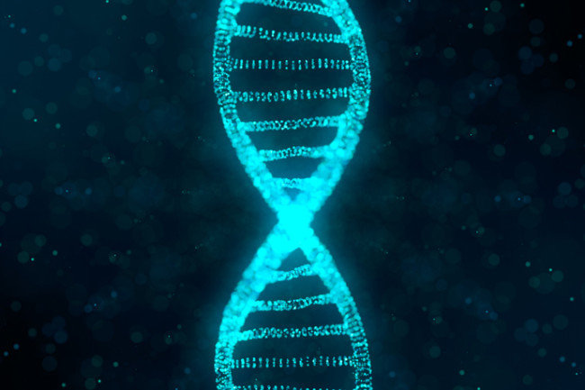

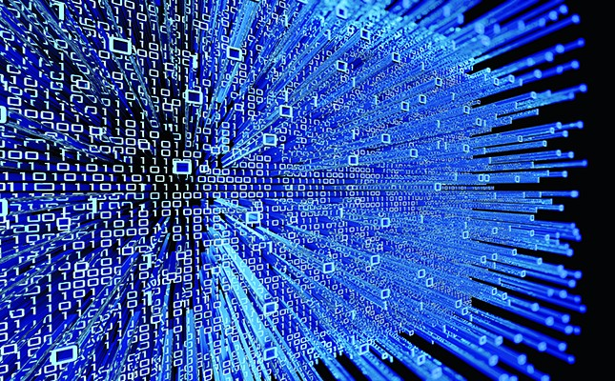
Applications
Cancer research might assay gene expression levels in 100 patients with cancer. You may be looking for subgroups among the cancer samples, or among the genes in order to obtain a better understanding of the disease.
Online shopping site might try to identify groups of shoppers with similar browsing and purchase histories, as well as items that are of particular interest within each groups.
Dealing with large datasets, you may want to reduce the dimensionality first and then train on the reduced dataset.

Slide 6
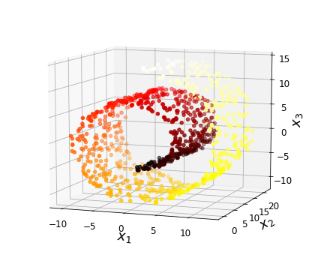
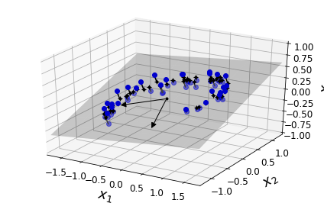
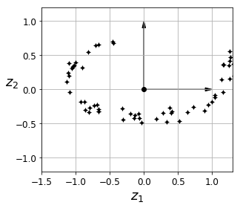
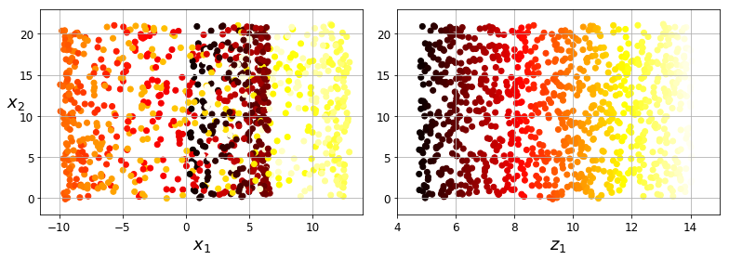
Projection vs. Manifold Learning
Manifold assumption: the data does not come from every part of the possible space but from a low-dimensional manifolds.

Slide 7
Principal Component Analysis (PCA)
When faced with a large set of correlated variables, principal components allow us to summarize this set with a smaller number of representative variables that collectively explain most of the variability in the set.
Principal components are direction in feature space along which the original data are highly variable.
PCA produces:
derived variables for use in supervised learning problems;
also serves as a tool for data visualization.

Slide 8
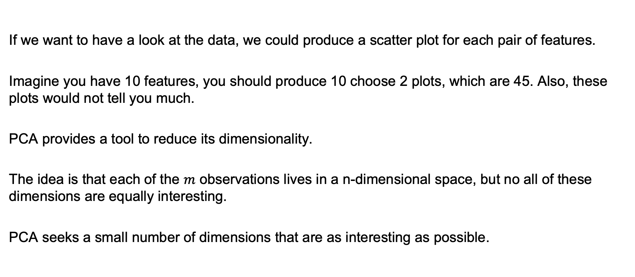
Understanding Data
If we want to have a look at the data, we could produce a scatter plot for each pair of features.
Imagine you have 10 features, you should produce 10 choose 2 plots, which are 45. Also, these plots would not tell you much.
PCA provides a tool to reduce its dimensionality.
The idea is that each of the $m$ observations lives in a n-dimensional space, but no all of these dimensions are equally interesting.
PCA seeks a small number of dimensions that are as interesting as possible.

Slide 9
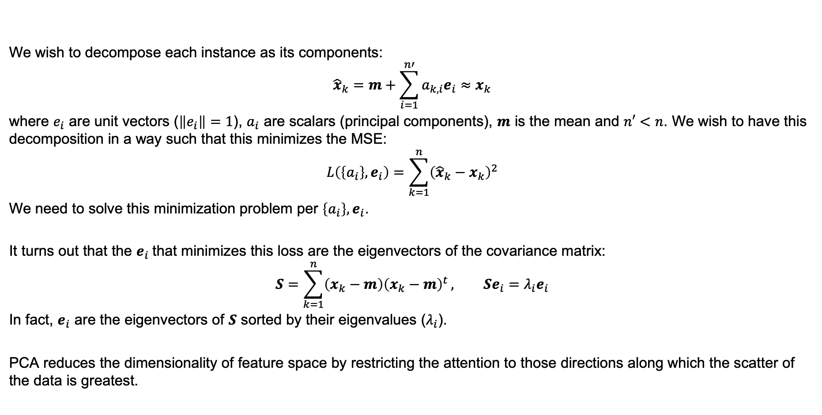
PCA Algorithm
We wish to decompose each instance as its components:
$${\hat{x}}_{k}=m+\sum_{i=1}^{n′}{a_{k,i}e_{i}}≈x_{k}$$
where $e_{i}$ are unit vectors ($\left\|e_{i}\right\|=1$), $a_{i}$ are scalars (principal components), $m$ is the mean and $n′<n$. We wish to have this decomposition in a way such that this minimizes the MSE:
$$L\left(\left\{a_{i}\right\},e_{i}\right)=\sum_{k=1}^{n}{{\left({\hat{x}}_{k}−x_{k}\right)}^{2}}$$
We need to solve this minimization problem per $\left\{a_{i}\right\},e_{i}$.
It turns out that the $e_{i}$that minimizes this loss are the eigenvectors of the covariance matrix:
$$S=\sum_{k=1}^{n}{\left(x_{k}−m\right){\left(x_{k}−m\right)}^{t}}, Se_{i}=λ_{i}e_{i}$$
In fact, $e_{i}$ are the eigenvectors of $S$ sorted by their eigenvalues ($λ_{i}$).
PCA reduces the dimensionality of feature space by restricting the attention to those directions along which the scatter of the data is greatest.

Slide 10
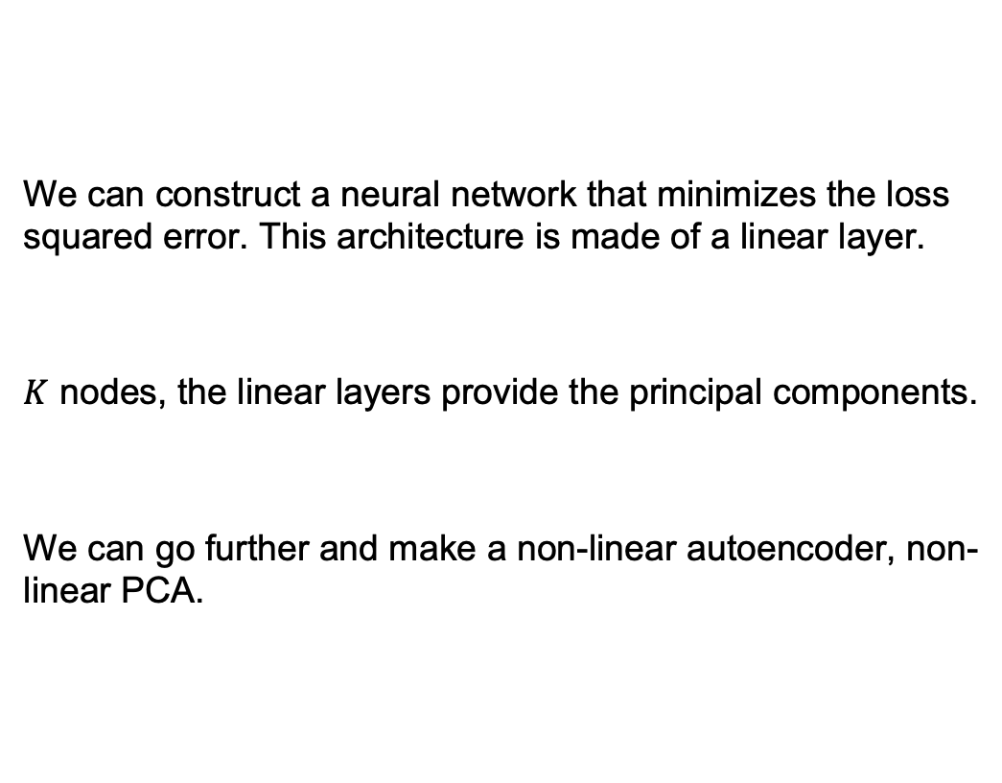
PCA and Autoencoders
We can construct a neural network that minimizes the loss squared error. This architecture is made of a linear layer.
$K$ nodes, the linear layers provide the principal components.
We can go further and make a non-linear autoencoder, non-linear PCA.

Slide 11
Independent Component Analysis
PCA seeks directions in feature space that best represent the data in a sum-squared error sense.
ICA seeks directions that are most independent from each other.
Imagine to have various signals together and you wish to separate them.

Slide 12
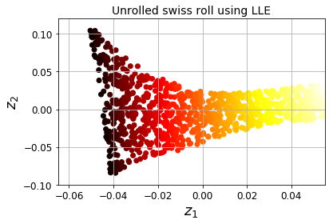
Locally Linear Embedding
LL first measures how each training example linearly relates to its closest neighbors then looks for a low-dimensional representation of the training set where these local relationships are best preserved.
This approach is particularly good at unfolding twisted manifolds.
For each example,
first finds the k-nearest neighbors;
then, tries to reconstruct a linear function of these neighbors trying to preserve the same distances in the lower dimensional space.

Slide 13
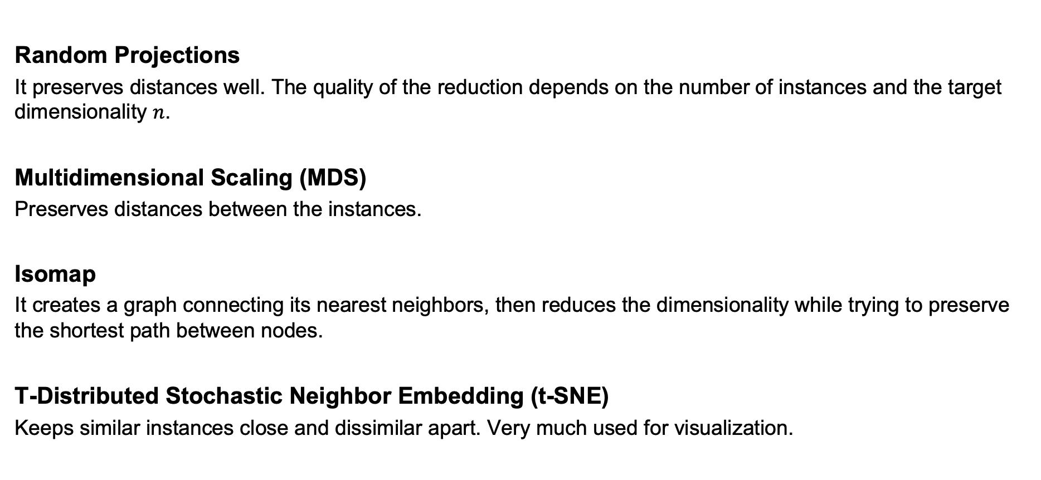
Other Dimensionality Reduction Methods
Random Projections
It preserves distances well. The quality of the reduction depends on the number of instances and the target dimensionality $n$.
Multidimensional Scaling (MDS)
Preserves distances between the instances.
Isomap
It creates a graph connecting its nearest neighbors, then reduces the dimensionality while trying to preserve the shortest path between nodes.
T-Distributed Stochastic Neighbor Embedding (t-SNE)
Keeps similar instances close and dissimilar apart. Very much used for visualization.

Slide 14
Clustering
We want to identify groups of similar instances, which we call clusters.
We are going to be looking at:
K-Means
DBSCAN
Gaussian Mixture Model

Slide 15

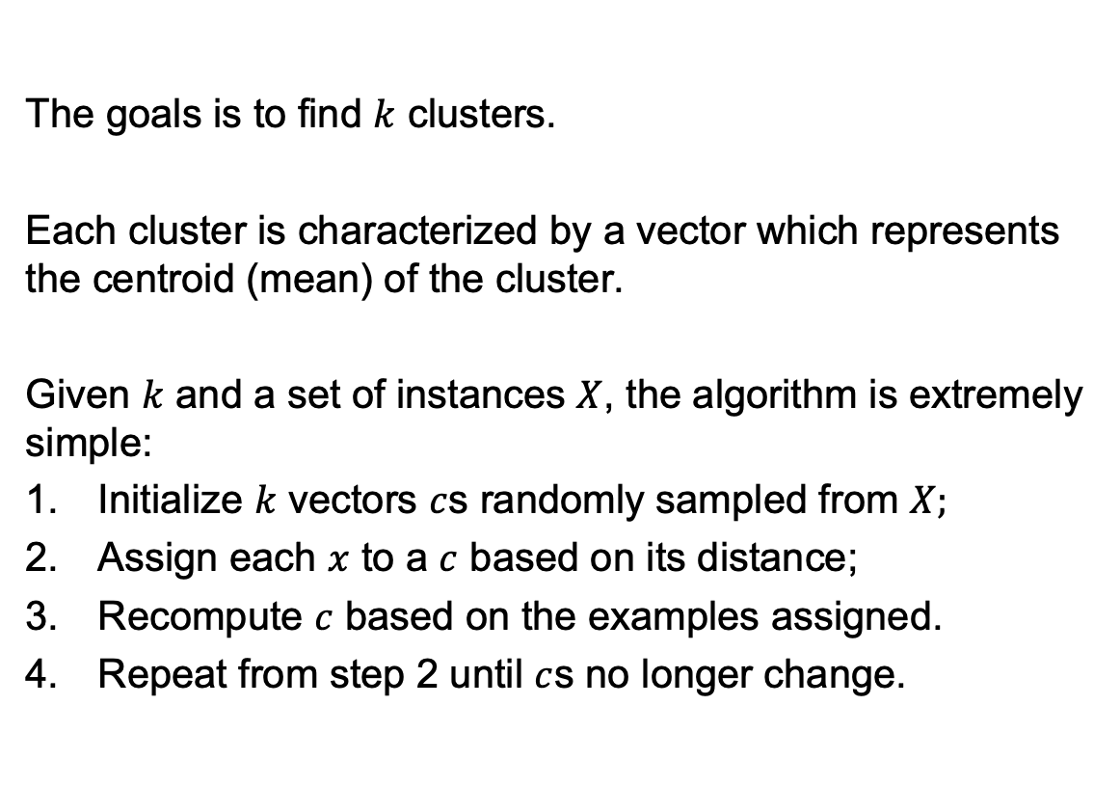
K-Means
The goals is to find $k$ clusters.
Each cluster is characterized by a vector which represents the centroid (mean) of the cluster.
Given $k$ and a set of instances $X$, the algorithm is extremely simple:
Initialize $k$ vectors $c$s randomly sampled from $X;$
Assign each $x$ to a $c$ based on its distance;
Recompute $c$ based on the examples assigned.
Repeat from step 2 until $c$s no longer change.

Slide 16
K-Means
It is fast and scalable.
It is necessary to run the algorithm more than once to avoid suboptimal solutions.
You need to specify the number of clusters.
It does not behave well when the clusters have varying size.

Slide 17
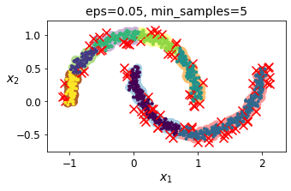
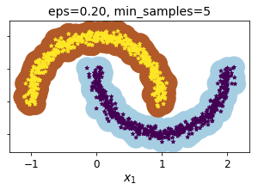
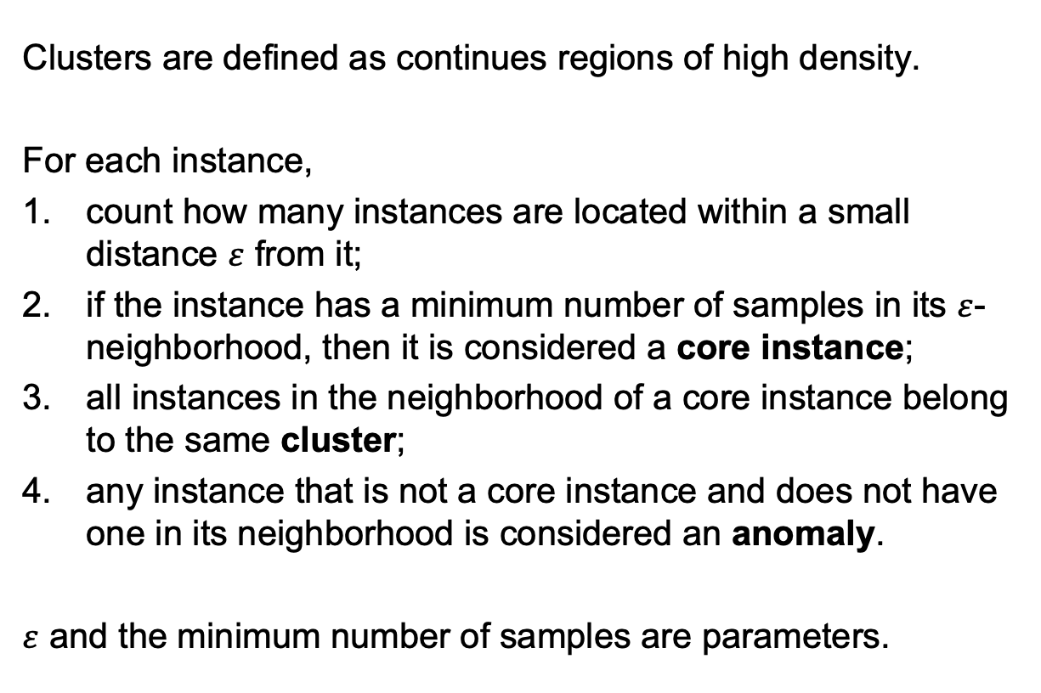
DBSCAN
Clusters are defined as continues regions of high density.
For each instance,
count how many instances are located within a small distance $ε$ from it;
if the instance has a minimum number of samples in its $ε$-neighborhood, then it is considered a core instance;
all instances in the neighborhood of a core instance belong to the same cluster;
any instance that is not a core instance and does not have one in its neighborhood is considered an anomaly.
$ε$ and the minimum number of samples are parameters.

Slide 18
DBSCAN
Robust to the shape of the data.
Robust to outliers.
It does not work if the density varies significantly across the clusters.

Slide 19
Gaussian Mixture Model
A Gaussian mixture model is a probabilistic model that assumes that the instances were generated from a mixture of several Gaussian distributions whose parameters are unknown.
It relies on the Expectation Maximization (EM) algorithm, similar to K-means.

Slide 20
Summary
Unsupervised Learning
Dimensionality Reduction
Principal Component Analysis (PCA)
Independent Component Analysis (ICA)
Locally Linear Embedding (LL)
Clustering
K-means
DBSCAN
Gaussian Mixture Models (GMM)

